Slide 1
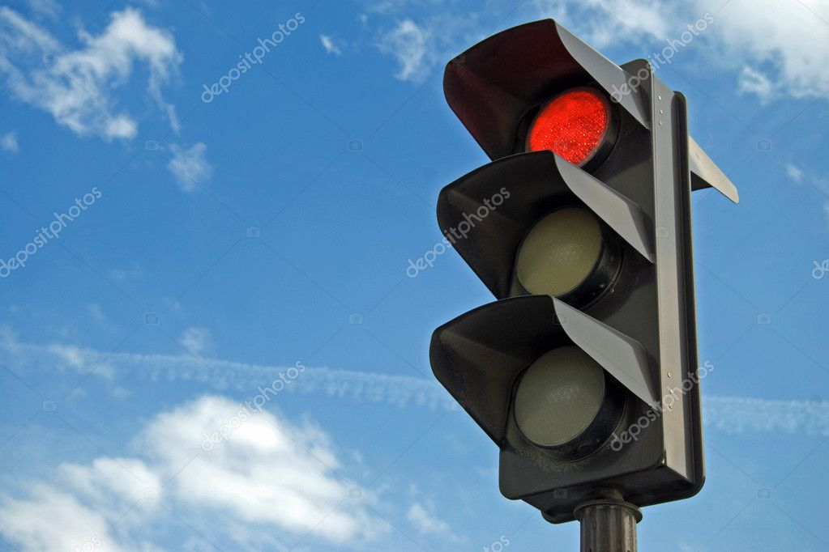
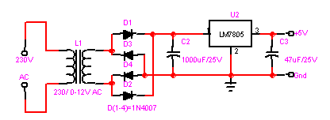
Working
The most common traffic lights work on simple timers.
Depending upon traffic levels at a particular intersection, the traffic light will cycle through green, yellow, and red at regular intervals to ensure a consistent flow of traffic in all directions through the intersection.
The main power is stepped down by transformer to deliver a secondary output of 9v, 300 mA.
The transformer out put is rectified by a full-wave bridge rectifier comprising diodes D1 through D4.

Slide 2
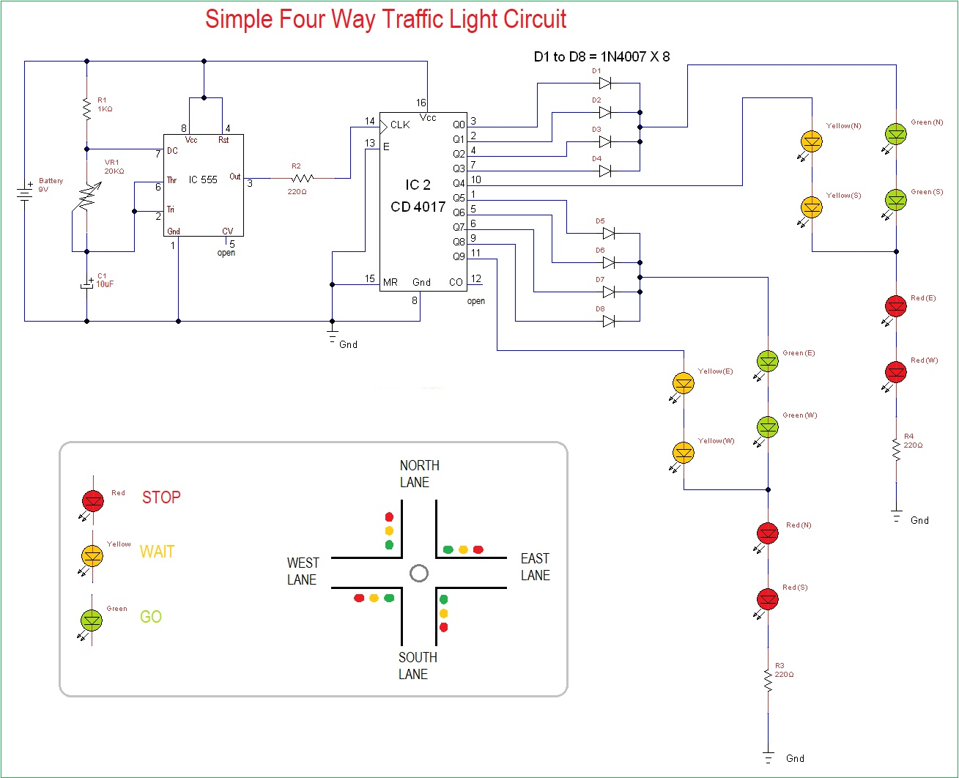
Working

Slide 3
Working
Four way traffic light circuit diagram using 555 Timer IC is shown in the above diagram.
The timer here generates pulses of time period 100ms approximately. So the ON time is 50ms and OFF time is 50ms.
The time duration can be changed by changing the capacitor value.
The time shift for a four way traffic light can be achieved in this circuit by replacing the 10uF capacitor with a 470uF.
Once the power is tune ON, the timer acts as a square wave generator and generates clock, this clock is fed to the decade binary counter.

Slide 4
Working
Now the decade binary counter counts the number of pulses given at the clock and lets the corresponding pin output go high, if the event count is 3 then Q2 pin of counter will be high and if 5 is count the pin Q4 will be high.
There will be a peak for every 100ms , with this peak the counter memory gains by one.
The diodes here prevent the shorting of counter outputs, say if the count is two with this the Q1 will be high (since Q1 is high all other outputs will be low including Q0, Q2) in the absence of diodes.
Q1 with positive voltage gets hardly pulled down to LOW by Q0 as they are connected together.

Slide 5
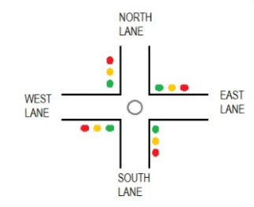
Working
During Q0, Q1, Q2, Q3 high the GREEN LED on NORTH and SOUTH will be ON along with RED LED on EAST and WEST.
If we assume clock is of 1Hz, the NORTH and SOUTH side are signaled GREEN to go for four sec and also the EAST and WEST side are signaled RED to STOP during this time.
When Q4 goes high, the YELLOW LED on NORTH and SOUTH will be ON along with RED LED on EAST and WEST.
If we assume clock is of 1Hz, the NORTH and SOUTH side are signaled YELLOW to slow down for 1sec and also the EAST and WEST side are signaled RED to STOP during this time.

Slide 6
Working
When Q5, Q6, Q7, Q7 high the green LED on EAST and WEST will be ON along with red LED on NORTH and SOUTH.
If we assume clock is of 1Hz, the EAST and WEST side are signaled green to go for four sec and also the NORTH and SOUTH side are signaled red to STOP during this time.
When Q4 goes high, the yellow LED on EAST and WEST will be ON along with red LED on NORTH and SOUTH.
If we assume clock is of 1Hz, the EAST and WEST side are signaled yellow to slow down for 1sec and also the NORTH and SOUTH side are signaled red to STOP during this time.
These above four stages form a continuous cycle, to control the traffic light on a four way.

Slide 7
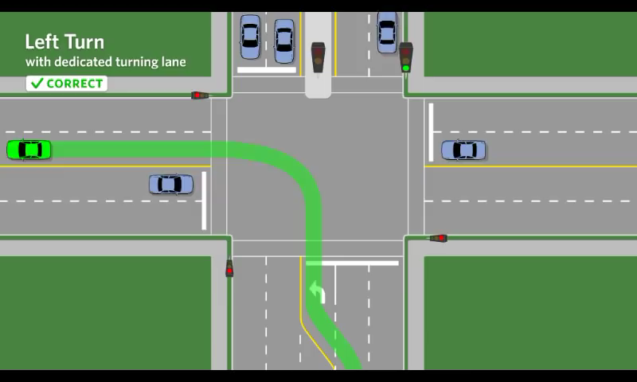
Working

